Slide 1
ONE
ABC PROJECT CORNERSTONE

Slide 2
AGENDA
One Summary and Goals
Mindfulness
Grades K-2 Lesson Overview and Tips
Grades 3-6 Lesson Overview and Tips
Schoolwide Extension

Slide 3

SUMMARY AND GOALS
Empathy: Understand and care about others' feelings.
Action: Be proactive and help those in need.
Impact: One person can make a difference.
Voice: Everyone has the power to make a change.
Forgiveness: Give others a second chance.

Slide 4
MINDFULNESS: HEARTBEAT EXCERCISE
Can be used to start the lesson or end the lesson, or sent home with students to try
Allows for connecting to breath and our power
https://www.youtube.com/watch?v=dZeXWt5KkbM
Notes:
Can use these mindfulness excercises at the beginning of your lessons, at the end, or send them home- do what makes the most sense!

Slide 5
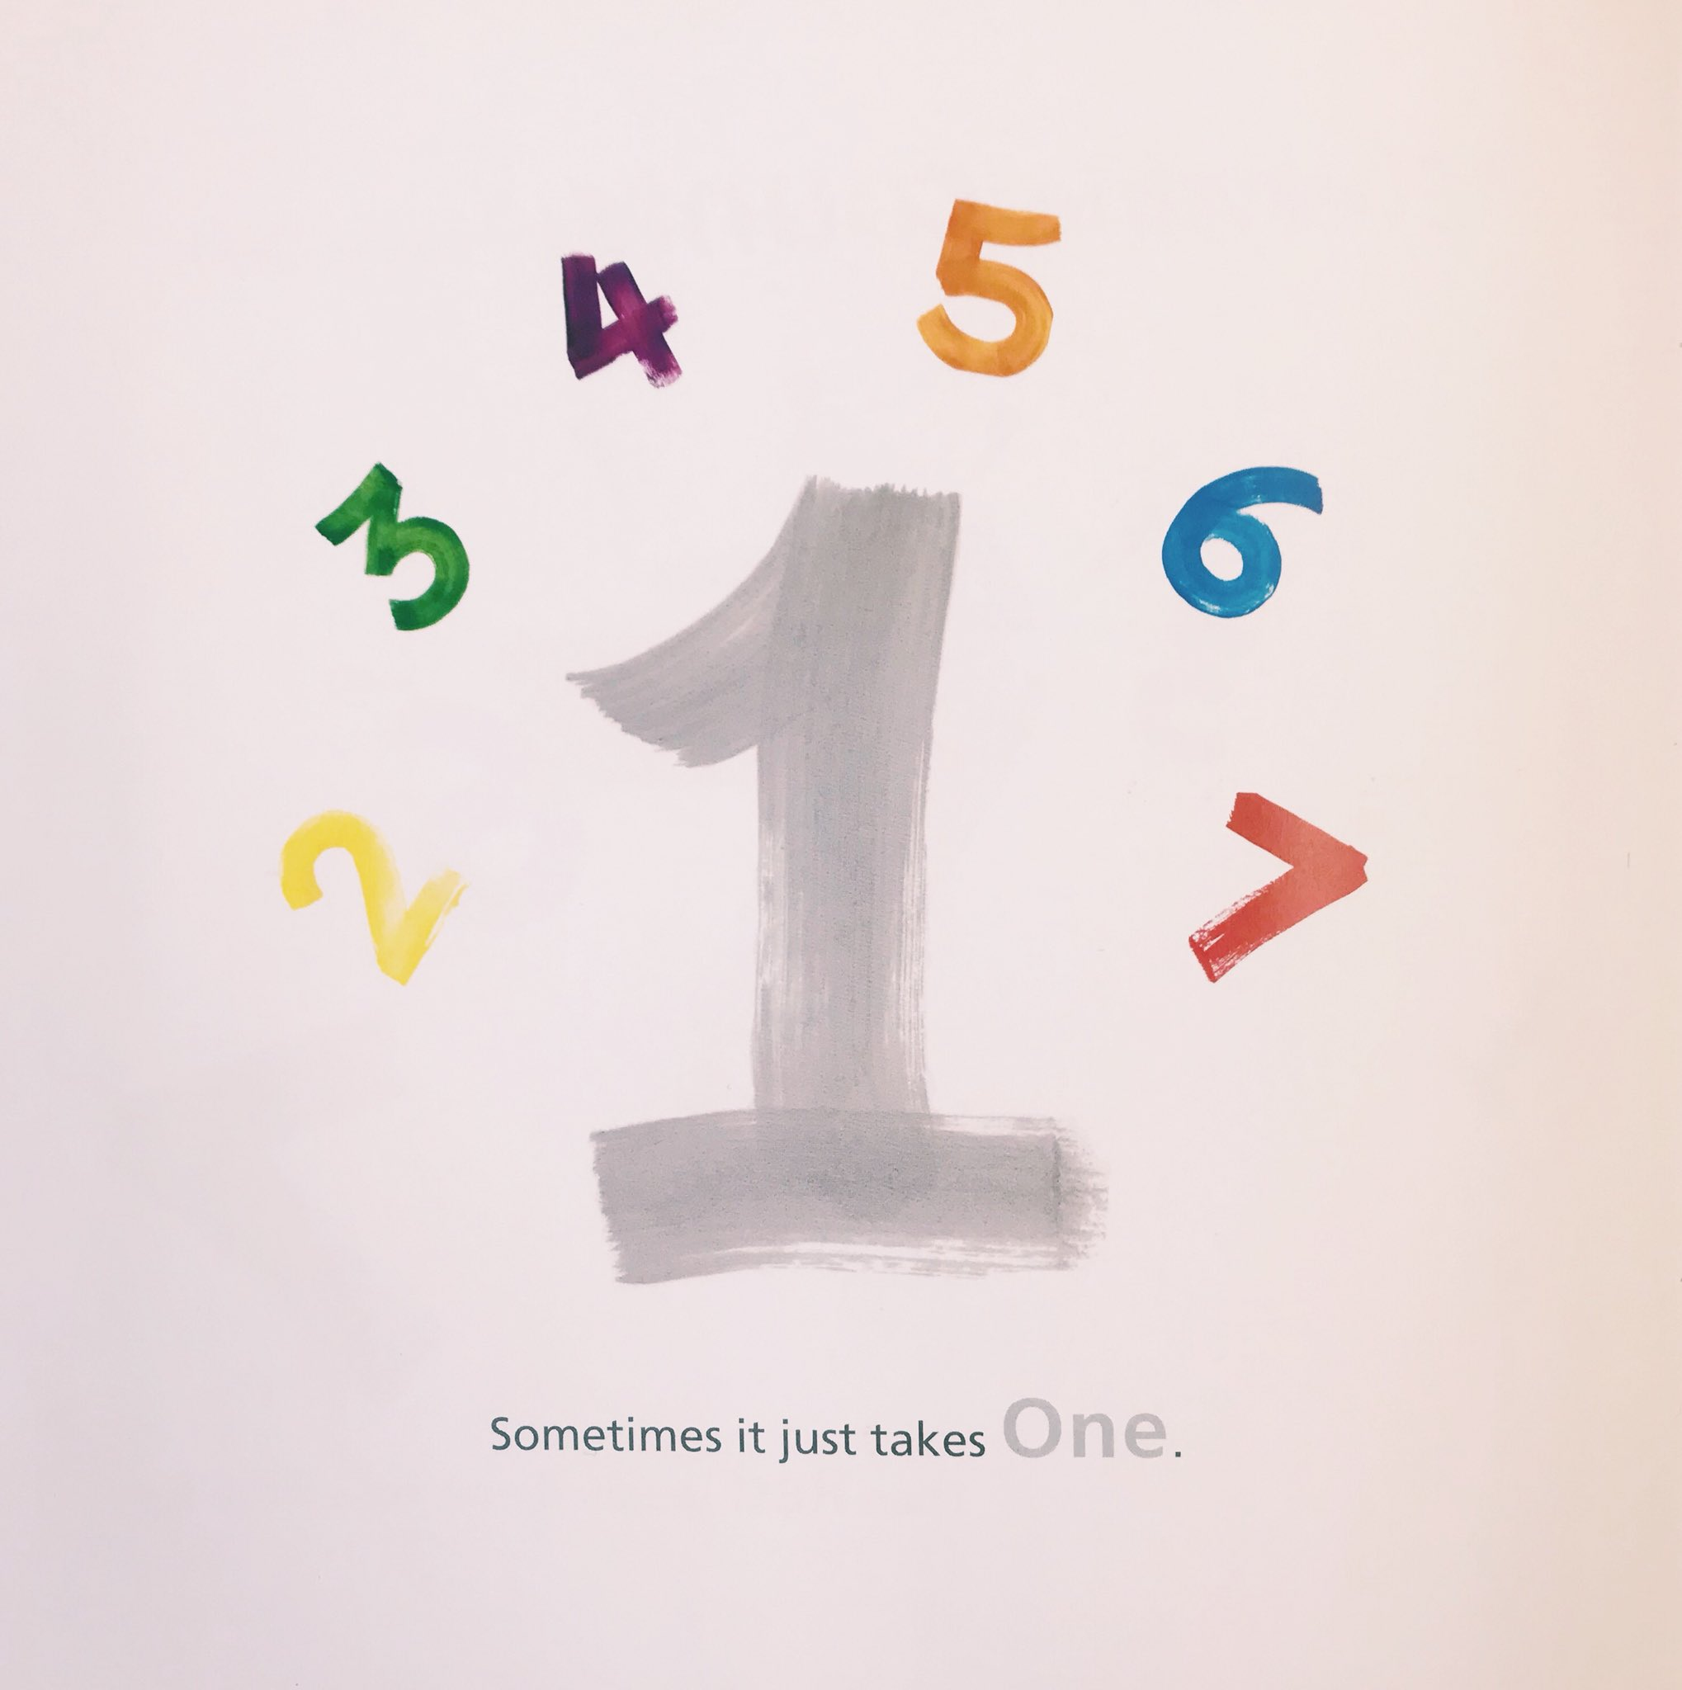
GRADES K-2

Slide 6
CONVERSATION STARTER: FEELINGS COUNT WITH K-2
Keep instructions short and clear
Offer specific color suggestions (e.g., "Let's color our shape red for anger or blue for calm")
Encourage simple sharing, like "I feel happy today because I played with my friend."
https://youtu.be/hmkigGC4ZEc
Notes:
Simplified Instructions: "Draw a shape and color it how you feel today. Is it a happy, sad, or silly color?" Focused Discussion: After sharing, ask simple questions like, "Does your color make you feel happy or sad?" or "What would you do if you felt that way?" Visual Support: Use picture cards or simple drawings to represent different emotions.
Today, we're going to explore a world of emotions - we're celebrating how we feel inside!
Hand out a piece of paper and make coloring materials available to each student.
Tell students to draw a shape on their paper. Say, “Now, pick a color that shows how you're feeling today! Is it happy yellow, calm blue, or maybe a fiery red? Color your shape in. It can be multiple colors too!”
Have students turn to a partner and share their shape and color. Say, “Let's talk about our colors! What does your color make you think of? When might you feel that way?”
Today we will see colors in the story and identify many different emotions that those colors feel.
Tell the students to listen to see how the colors feel while reading the book.
Act out different emotions to help students understand and express them.

Slide 7
READING THE BOOK TO K-2
Use bucket language- “bucket dipper” vs. “being mean”
Focus on the visual cues they can see and ask simple questions for comprehension
https://youtu.be/ef9JUWhfVKI
Notes:
Visual Focus: Emphasize the colorful illustrations and ask simple questions like, "What color is the shape that is being a bucket dipper?" or "What color is the shape that helps?" Simplified Discussion: Discuss basic emotions like happy, sad, and angry. Ask questions like, "How do you think the shapes felt when they were being bucket dippers? How did they feel when they were being bucket fillers?"

Slide 8
DISCUSSING THE BOOK WITH K-2
How would you describe Blue?
Tell me about Red.
What about the other colors?
How would you feel if there was someone who acted like Red on the playground?
How did the other colors help Red?
How can you be more brave like One?
Notes:
How would you describe Blue?
Tell me about Red.
What about the other colors?
How would you feel if there was someone who acted like Red on the playground?
How did the other colors help Red?
How can you be more brave like One?

Slide 9
ACTIVITY OPTION: 1 ENVELOPE K-2
Fun surprise for kids to all open a “one” envelope
Focus on what it means to be “One” after they open their envelope with a class discussion
K- break it down to three categories like share, help others, invite
1- encourage thinking about different areas at school they can apply this learning
2- how can they be “One” for themselves and for others?
https://youtu.be/bvJCqJ6pH1E
Notes:
Write their names on their ones for an extension, or create keychain or pin for each child

Slide 10
ACTIVITY OPTION: COLORED FEELINGS K-2
Keep emotions basic and give visual cues for different emotions
Create an example ahead of time of what they could create
K- might be one emotion they can choose to draw
1- might be an emotion chart
2- might be an emotion chart with ways they work through that emotion or what can cause that emotion
- There are many options, you choose one that will work for your group to give them
https://www.youtube.com/watch?v=LnJE7jaWHrI

Slide 11
REFLECT on K-2
What questions do you have moving forward with this lesson?
What do you see going well?
What issues might come up?

Slide 12
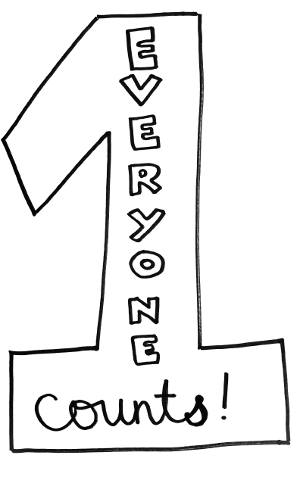
GRADES 3-6

Slide 13
CONVERSATION STARTER: FEELINGS COUNT WITH 3-6
Encourage students to choose colors that express their complex emotions (e.g., shades of blue for calm or anxious).
Prompt students to discuss their feelings in more detail, such as "Why did you choose that color?" or "How does that color make you feel?“
Ask students to consider how they can manage their own emotions and express them healthily.
https://youtu.be/eivpRQLev_Q
Notes:
Today, we're going to explore a world of emotions - we're celebrating how we feel inside!
Hand out a piece of paper and make coloring materials available to each student.
Tell students to draw a shape on their paper. Say, “Now, pick a color that shows how you're feeling today! Is it happy yellow, calm blue, or maybe a fiery red? Color your shape in. It can be multiple colors too!”
Have students turn to a partner and share their shape and color. Say, “Let's talk about our colors! What does your color make you think of? When might you feel that way?”
Today we will see colors in the story and identify many different emotions that those colors feel.
Tell the students to listen to see how the colors feel while reading the book.
Act out different emotions to help students understand and express them.
Deeper Exploration: Encourage students to think about specific situations that might trigger certain emotions. Expanded Color Palette: Introduce more complex color combinations to represent nuanced emotions. Reflective Journaling: Have students write a short reflection about their chosen color and emotion.

Slide 14
READING THE BOOK TO 3-6
Respond while they listen to the book on their own papers
Encourage critical thinking and considering their own experiences and how they can relate to different colors
Use Diagraming the One Story PDF under Materials while reading
https://youtu.be/H_1qiRDXjOo
Notes:
Critical Thinking: Ask deeper questions like, "Why do you think the shapes reacted the way they did?" or "What could have happened if the shapes had acted differently?"

Slide 15
DISCUSSING THE BOOK WITH 3-6
Question 1: Encourage students to share their emotional responses to Red's behavior. Ask them to describe how they would feel if they were in Blue's position.
Question 2: Guide students to identify the specific actions of the other shapes that led to Blue's liberation. Discuss the power of collective action.
Question 3: Encourage students to think about their own strengths and how they can use them to help others.
Question 4: Guide students to analyze the symbolism of the colors and numbers. Ask them how these elements contribute to the overall meaning of the story.
Questions 5-7: Encourage students to share personal experiences related to the themes of the book. Ask open-ended questions to spark discussion and reflection.
https://www.youtube.com/watch?v=5XMxIMNsViU
Notes:
. Foster a Safe and Respectful Environment:
Establish Ground Rules: Remind students to listen respectfully to each other's ideas.
Validate All Responses: Acknowledge each student's contribution, even if it's a different perspective.
4. Ask Follow-Up Questions:
Dig Deeper: Encourage students to elaborate on their answers by asking follow-up questions like, "Can you tell me more about that?" or "Why do you think that happened?“
How did seeing Red act that way make you feel (focus on identifying and expressing emotions)?
What do you think gave One the power to stand up to Red?
Reflect to yourself on the qualities you have that are like the colors in the story?
There are many dual-meaning words in the book. Which ones stood out to you? (ex: One, blue, count, hot, cool) Are there other metaphors you can see within the book? (strength in numbers, sizes and statures of colors and numbers, etc.)
Do you have experiences with anyone being brave and inclusive like One?
Have you ever given someone a second chance?
Have you been give a second chance?
What does the phrase “it just takes one” mean to you?

Slide 16
ACTIVITY OPTION: COLORED FEELINGS 3-6
Opportunity to reflect on feelings in the book as they relate to them
Can turn on music and let students watercolor quietly- you can play many types of music to showcase emotions or stick to one genre
Can have a slideshow of artwork or emotions or social situations as inspiration for them
Open ended- can make a chart or just artwork, give examples.
Austin’s video, linked previously
Notes:
Complex Emotions: Encourage students to explore more complex emotions, such as envy, jealousy, or guilt. Cultural Differences: Discuss how different cultures express emotions and how these expressions might vary. Art Therapy: Explore the therapeutic benefits of art and how it can be used to express emotions.
For Struggling Learners:
Simplified Instructions: Provide clear, step-by-step instructions and visual examples.
Guided Practice: Work with students one-on-one or in small groups to help them brainstorm ideas and complete their charts.
Limited Color Palette: Provide a limited number of colors to reduce overwhelm.
Common Activity for All:
Shared Gallery: Create a class display of the students' feelings charts.
Journaling: Have students write about their feelings and how they express them.
Mindfulness Exercises: Incorporate mindfulness activities to help students regulate their emotions.

Slide 17
ACTIVITY OPTION: GUESS MY EMOTION 3-6
Acting out emotions, recognizing cultural differences when it comes to emotional expression
Sharing when or why they feel that emotion- Get Off the Escalator PDF in materials
Ways they can work through that emotion when it is more negative
How can we help one another in the working through emotions?
https://www.youtube.com/watch?v=N3AX75bxzFc
Notes:
Setting up a safe environment-
Complex Scenarios: Present more complex scenarios that require nuanced emotional responses, such as dealing with a difficult peer or a challenging academic situation. Improvisation: Encourage students to improvise their responses to unexpected situations, fostering creativity and adaptability. Self-Reflection: Ask students to reflect on their own emotional experiences and how they can apply these insights to their interactions with others.
Simplified Scenarios: Provide clear and concise scenarios that are easy to understand. Visual Cues: Use visual aids, such as pictures or emojis, to help students identify and express emotions. Peer Support: Pair students with more confident peers to encourage participation and provide support.

Slide 18
REFLECT on 3-6
What questions do you have moving forward with this lesson?
What do you see going well?
What issues might come up?

Slide 19
CLOSING AFFIRMATIONS
It just takes one to make a difference on a team, in a classroom, a school, and a community
Read the affirmations while students think of how the statements apply to them
https://www.ymcasv.org/ymca-project-cornerstone/materials-lessons/abc-materials-lesson-plans/abc-asset-year/one

Slide 20
SCHOOLWIDE EXTENSIONS:
ONE FOR EACH OTHER
Giant “Ones” written around the school or on classroom doors
Personalize them with positive ways students make a difference in each other’s lives every day

Slide 21
SCHOOLWIDE EXTENSIONS:
“ONE” MAKES A DIFFERENCE SHOWCASE
Community members come present at a schoolwide assembly and share ways they/ their profession makes a difference in the community
A fun addition would be having students present about teachers being “the one” for them in their lives
Can keep the extension going with a service challenge like a schoolwide cleanup or community beautification
Notes:
Invite community members to come to a schoolwide assembly and share ways they make a difference. You can have different vocations and volunteerism represented. Ask the upper grades at your school to surprise the teachers and staff with a presentation of how they are the ‘One’ for students in their lives.
Following the assembly, organize a school-wide community service challenge. Partner with local organizations and have each grade level participate in a service project that aligns with their age and interests. This reinforces the "One" message by taking action in the community.
This is to remind students that anyone can have positive power over any group. Draw a giant ‘1’ in chalk on the blacktop. Make it in block lettering so students can draw and write ways they and others are enough to make a change.
Ask for parent volunteers to come help during recess and lunch for one day while students have the opportunity to add to the big 1.
Add ‘1’s or phrases from the affirmations around the school for students to see and consider the ways they are enough for those around them.
An adaptation of this could be having each classroom have a giant 1 on the door. On that ‘One’, students could write affirmations about themselves and their peers, celebrating their unique strengths and contributions to the school.

Slide 22
THANK YOU!
See you at the Volunteer Celebration on December 12th!

