Slide 1
COOL DOWN AND WORK THROUGH ANGER
TRANSITIONAL KINDERGARTEN/ KINDERGARTEN
PROJECT CORNERSTONE
OCTOBER 2024

Slide 2
AGENDA SLIDE
BOOK OVERVIEW/ LESSON GOALS
CONVERSATION STARTER
READING THE BOOK
DISCUSSION
ACTIVITY OPTIONS

Slide 3


Slide 4
CONVERSATION STARTER
Use the same puppet or bring a different one each time!
Time to engage with the kids and get them thinking about the main message of the book
https://www.youtube.com/watch?v=qMndkmwU6HA

Slide 5
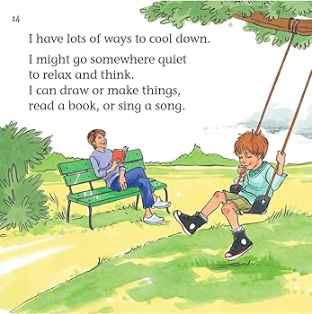
READING THE BOOK TO TK/K
More text- be strategic and ask them to look for certain things as you’re reading- facial expressions, words, etc
Most students will love being read to, especially if they can see the pictures, and especially if you help make the book come alive.
https://www.youtube.com/watch?v=CsngjVyKpPY
Notes:
They may love the whole book and sit there through it all, but be prepared to adjust if they get fidgety or theie eyes start glazing over.
Practice the methods of calming down together in the middle of the book.
Count to 10. Breath in deeply.
Name the people you like to spend time doing or something you always feel happy doing.
Just like if you were to do your whole discussion after the book, vary responses and give students opportunities to think and reflect.

Slide 6
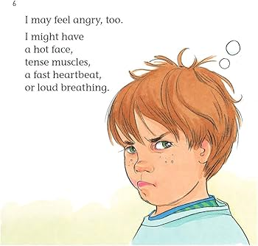
DISCUSSION OF THE BOOK
Ask during reading for these younger learners
Vary types of responses you are asking of the students
  Verbal, visual, think-pair-share
Notes:
How can you work through your anger?
What do you like to do to calm down?
Why is it important to say, “I’m sorry”?
What does it mean to forgive someone?
How does saying “I’m sorry” or forgiving someone help you get along with other people?

Slide 7
FLOWER CANDLE
LETTING STUDENTS PRACTICE A CALMING TECHNIQUE
You can do an example with a real flower and candle to make it more visually memorable
Can have them draw one of each to hold and practice
https://www.youtube.com/watch?v=KY-csEubVTI
Notes:
Have the children hold one hand out in front of them.
Say, “In this hand you are holding a beautiful flower. Imagine what it looks like, its shape and color. Hold it up and show me your flower.”
Say, “Now hold out your other hand. Imagine that in this hand you are holding a candle. Be very careful.”
Say, “I want everyone to take a nice, deep breath and smell the flower. Now, blow out the candle. Try it again. Smell the flower, blow out the candle.”
Remind them that when they are feeling angry, they can smell the flower and blow out the candle for some deep, calming breaths.

Slide 8
THE ANGRY BALLOON
Limit responses to a certain number (4-5)
Choose one or two of these strategies to even say
Practice one together
Notes:
Stand in front of the class with a deflated balloon. Ask the students for examples of what makes them angry (remind them of the no name rule).
With each answer blow some air into the balloon. As the balloon gets larger students will begin to react.
Ask, “What will happen with all this anger?” (It will pop. Just like you might “pop” and blow your top.)
Ask, “What can we do to calm this anger?” As students make suggestions you can release air from the balloon slowly with each response or after all the suggestions, let the balloon go.
If there is time, choose one of the strategies from the handout to practice as a group.
Send home the parent letter with the Cool Down Strategies handout attached. Have each student select one of the strategies that they will practice at home.

Slide 9
STARFISH BREATHING
https://www.youtube.com/watch?v=QKNnpylLdr0&list=PLBsUra9Uf_EwZGUDXg2fOI7z_rJTJgR8V&index=1

Slide 10
CLOSING
Finish with one reminder of ways to cool down and work through anger
Thank them for spending this time with you
Notes:
Today we talked about feeling angry and what we can do to work through the anger.
Give me a thumbs up if you can think of one way to cool down your anger.
Excellent! Now we are going to count to 3 and say, “Keep your cool.”
Wave goodbye, friends.

Slide 11
SCHOOLWIDE EXTENSION
Cool Down Spot
In your classroom, out at recess, or shared area for students to access
Notes:
Set up a designated area in the classroom where students can go to cool down when they are feeling angry. Make the space inviting with a special rug, pillows, or soft seating. If space is available, have balls to squeeze, drawing materials, headphones for music, or other soothing objects to use. The more inviting an environment, the more students will be able to regulate and calm down in this space.

Slide 12
THANK YOU

