Slide 1
Have You Filled a Bucket Today?
TRANSITIONAL KINDERGARTEN/ KINDERGARTEN TRAINING

Slide 2
WELCOME AND GETTING TO KNOW YOU
Share your name, District, how many years reading for PC, and favorite season of the year
- Verbally or over chat

Slide 3
AGENDA FOR TRAINING
OVERVIEW OF VOLUNTEER RESPONSIBILITIES
  YOUR FIRST CLASSROOM EXPERIENCE
  TK/K CLASSROOM MANAGEMENT TIPS
BOOK SUMMARY
  CONVERSATION STARTER
  READING THE BOOK
  DISCUSSION QUESTIONS
  ACITITY OPTIONS
  CLOSING
FINAL THOUGHTS AND QUESTIONS

Slide 4
VOLUNTEER STEPS AND RESPONSIBILITIES
FILL OUT YOUR PROJECT CORNERSTONE VOLUNTEER FORMS
FULFILL REQUIREMENTS SET BY YOUR DISTRICT AND SCHOOL
SIGN UP WITH YOUR SCHOOL’S LEAD AND CONTACT YOUR CLASSROOM TEACHER
READ THE BOOK OR THE LESSON PLAN AND KEEP UP WITH YOUR LEAD’S TRAININGS OFFERED
ATTEND OUR ZOOM TRAININGS OR WATCH RECORDINGS
SEEK HELP FROM YOUR SCHOOL’S LEAD OR ME
Notes:
When asking them to share their names- this can be an opportunity to help students

Slide 5
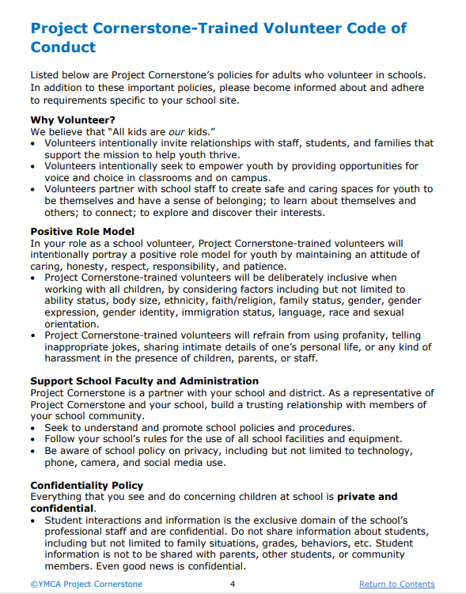
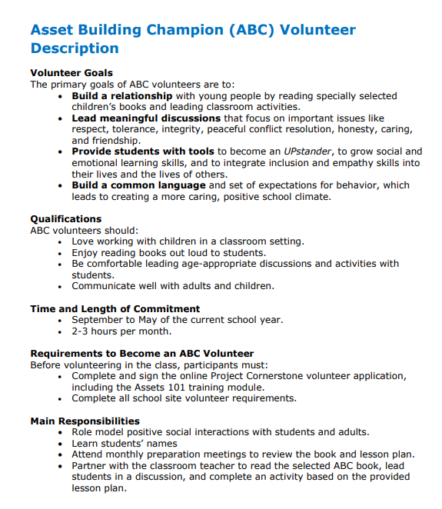
VOLUNTEER GUIDE
Notes:
Clarify roles: Explain the expectations for parent volunteers.Training Requirements: Emphasize the importance of completing the required training.

Slide 6
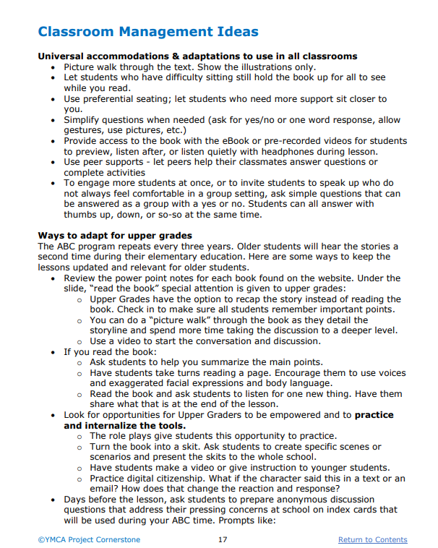
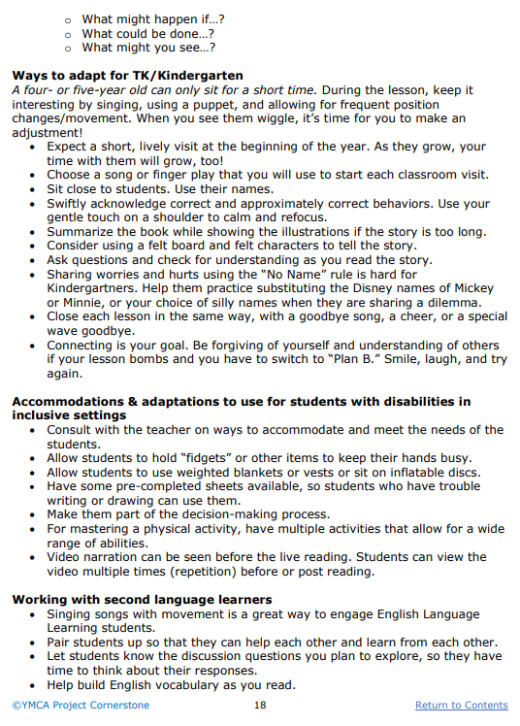
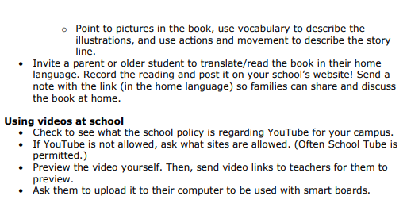
CLASSROOM MANAGEMENT TIPS

Slide 7
YOUR FIRST CLASSROOM EXPERIENCE
GREET THEM EXCITEDLY
- In a way that feel natural to you
TELL THEM BRIEFLY WHO YOU ARE AND WHY YOU ARE THERE
- I’m the parent of ____, I’ll be coming to read to you every month this year!
LEARN THEIR NAMES- GET NAME TAGS!
- There are so many excited faces in here, I can’t wait to learn all of your names.
SHOW INTEREST
- Look at them while they speak, repeat part of what they say back to them so they know you heard them. Encourage other students to listen too.
USE A PUPPET
Notes:
When asking them to share their names- this can be an opportunity to help students learn each others’ names too

Slide 8
CONVERSATION STARTER
Priming students to receive the lesson
Each lesson will have a puppet conversation about the subject which sets students up to hear the vocabulary and get thinking about the content
Notes:
Each lesson has a conversation starter which involves a puppet. This intro into the subject, vocabulary, and content that will be covered is key to the students getting the most out of the lesson. It can also be called “front loading” and another reason it is valuable is because of the confidence students can feel throughout the lesson when asked questions that they have been primed for through the conversation starter.

Slide 9
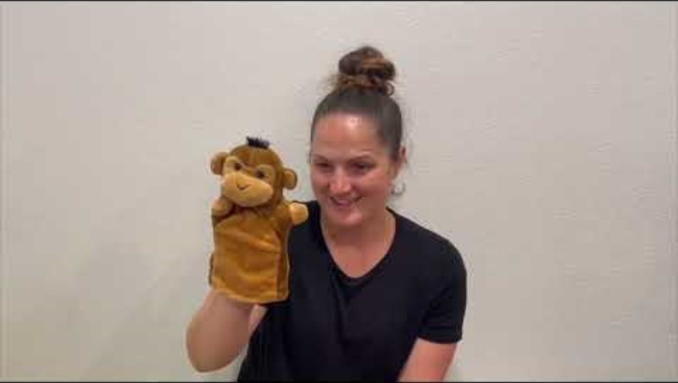
AMY: PUPPET MASTER
Insert silhouetted, background, or full-bleed image in this slide, then delete this text box

Slide 10
READING THE BOOK
Make guesses before beginning and throughout where applicable. This fosters awareness of cause and effect as well as problem solving throughout the reading

Slide 11
READING THE BOOK
Read the book at least once before going into the classroom.
Ask the teacher where you will be reading/ where the students will be sitting
If you ask open ended questions while reading prepared to get them back on track
    TK might not be able to sit for all the words. Adapt.
Notes:
Book Familiarity: Encourage volunteers to read the assigned books in advance.Activity Preparation: Discuss how to prepare for the planned activities and discussions.Student Engagement Strategies: Share tips for keeping students engaged and interested.

Slide 12
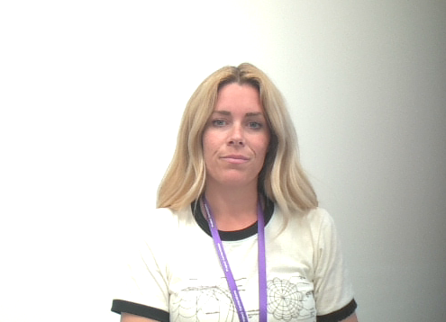
PRE READING THE BOOK EXAMPLE
Notes:
Tell the class that today you are going to read a book that talks about ways you can be kind and feel happy, and make others feel happy. When we hear kindness let’s make a heart with our hands. Can you do that? (Demonstrate with your hands.) Everyone, show me your heart. As you read, pause, and prompt the students to make a heart when they hear words or acts of kindness. Show students the book and read the cover and author’s name. • Say, “This book is called Have You Filled a Bucket Today? o Look at the cover of this book. o What do you think it is about? o What does it mean to fill a bucket?” • Say, “Let’s open it up and find out how we fill buckets!”

Slide 13
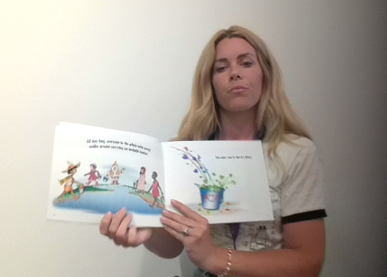
READING ALOUD EXAMPLE

Slide 14
DISCUSSION QUESTIONS
  They will get off topic. They have things they want to share. You are still modeling to them respect received and given.

Slide 15
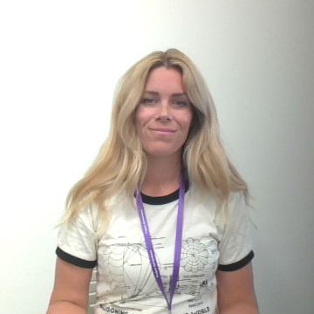
DISCUSSION QUESTIONS
  Some of these questions come up naturally while reading, or you can save them all for the end
    1. How do you feel when someone has dipped into your bucket?
    2. Have you ever dipped into someone’s bucket?
    3. What acts of kindness can you do to fill a bucket?
Notes:
Now that we have read this great book- we are going to share what we have learned for how we can fill each others’ buckets some more and our own personal experiences with that! When we share a story though, we aren’t going to use anyone’s name. If you have something to tell your teacher or grown up at home about someone, you can do that later, but for now we won’t say someone’s name when we share a story.
1. How do you feel when someone has dipped into your bucket?
2. Have you ever dipped into someone’s bucket?
3. What acts of kindness can you do to fill a bucket?

Slide 16
ACTIVITY OPTIONS
Be a Bucket Filler
Buckets of Kindness

Slide 17
BE A BUCKET FILLER
Role Play is proven to be one of the best ways to teach all the skills we are trying to teach in Project Cornerstone.
“Let’s try that again” allows them to physically say the words and do the actions that we want them to.
  Simple words and keeping it short for Transitional Kindergarten students is key
    Add smiling at each other and let them feel how they feel good when they smile and that the other person feels good too
    Kindergarten- turn to a partner, smile and say, “I hope we can play together at recess!”
Notes:
At this point your students may need to stand up and stretch a bit. So have them act out this simple skit. • OK everyone let’s pretend to be a bucket filler. • Everyone stand up tall. • Imagine you have a bucket. • Let’s stoop down and pick up a smile. (Pretend to grab something off the ground.) • Everyone smile! Make it a big happy smile. Turn around and smile at the teacher. • Put your smile in your pretend bucket! • Hooray bucket filling is fun! Let’s pretend to put our buckets on the ground and sit down.

Slide 18
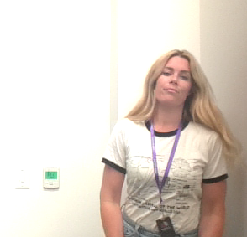
BE A BUCKET FILLER EXAMPLE
Notes:
At this point your students may need to stand up and stretch a bit. So have them act out this simple skit. • OK everyone let’s pretend to be a bucket filler. • Everyone stand up tall. • Imagine you have a bucket. • Let’s stoop down and pick up a smile. (Pretend to grab something off the ground.) • Everyone smile! Make it a big happy smile. Turn around and smile at the teacher. • Put your smile in your pretend bucket! • Hooray bucket filling is fun! Let’s pretend to put our buckets on the ground and sit down. (With the TK students, stop here and do the cheer to end the lesson.)

Slide 19
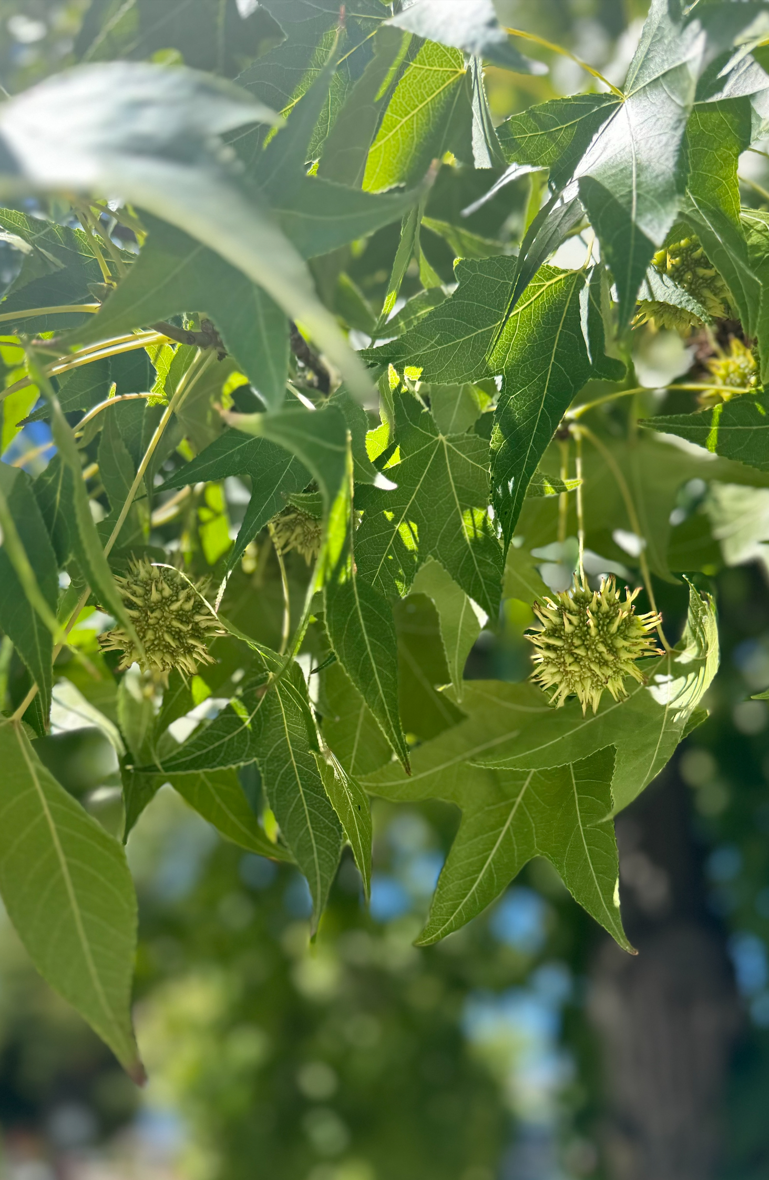
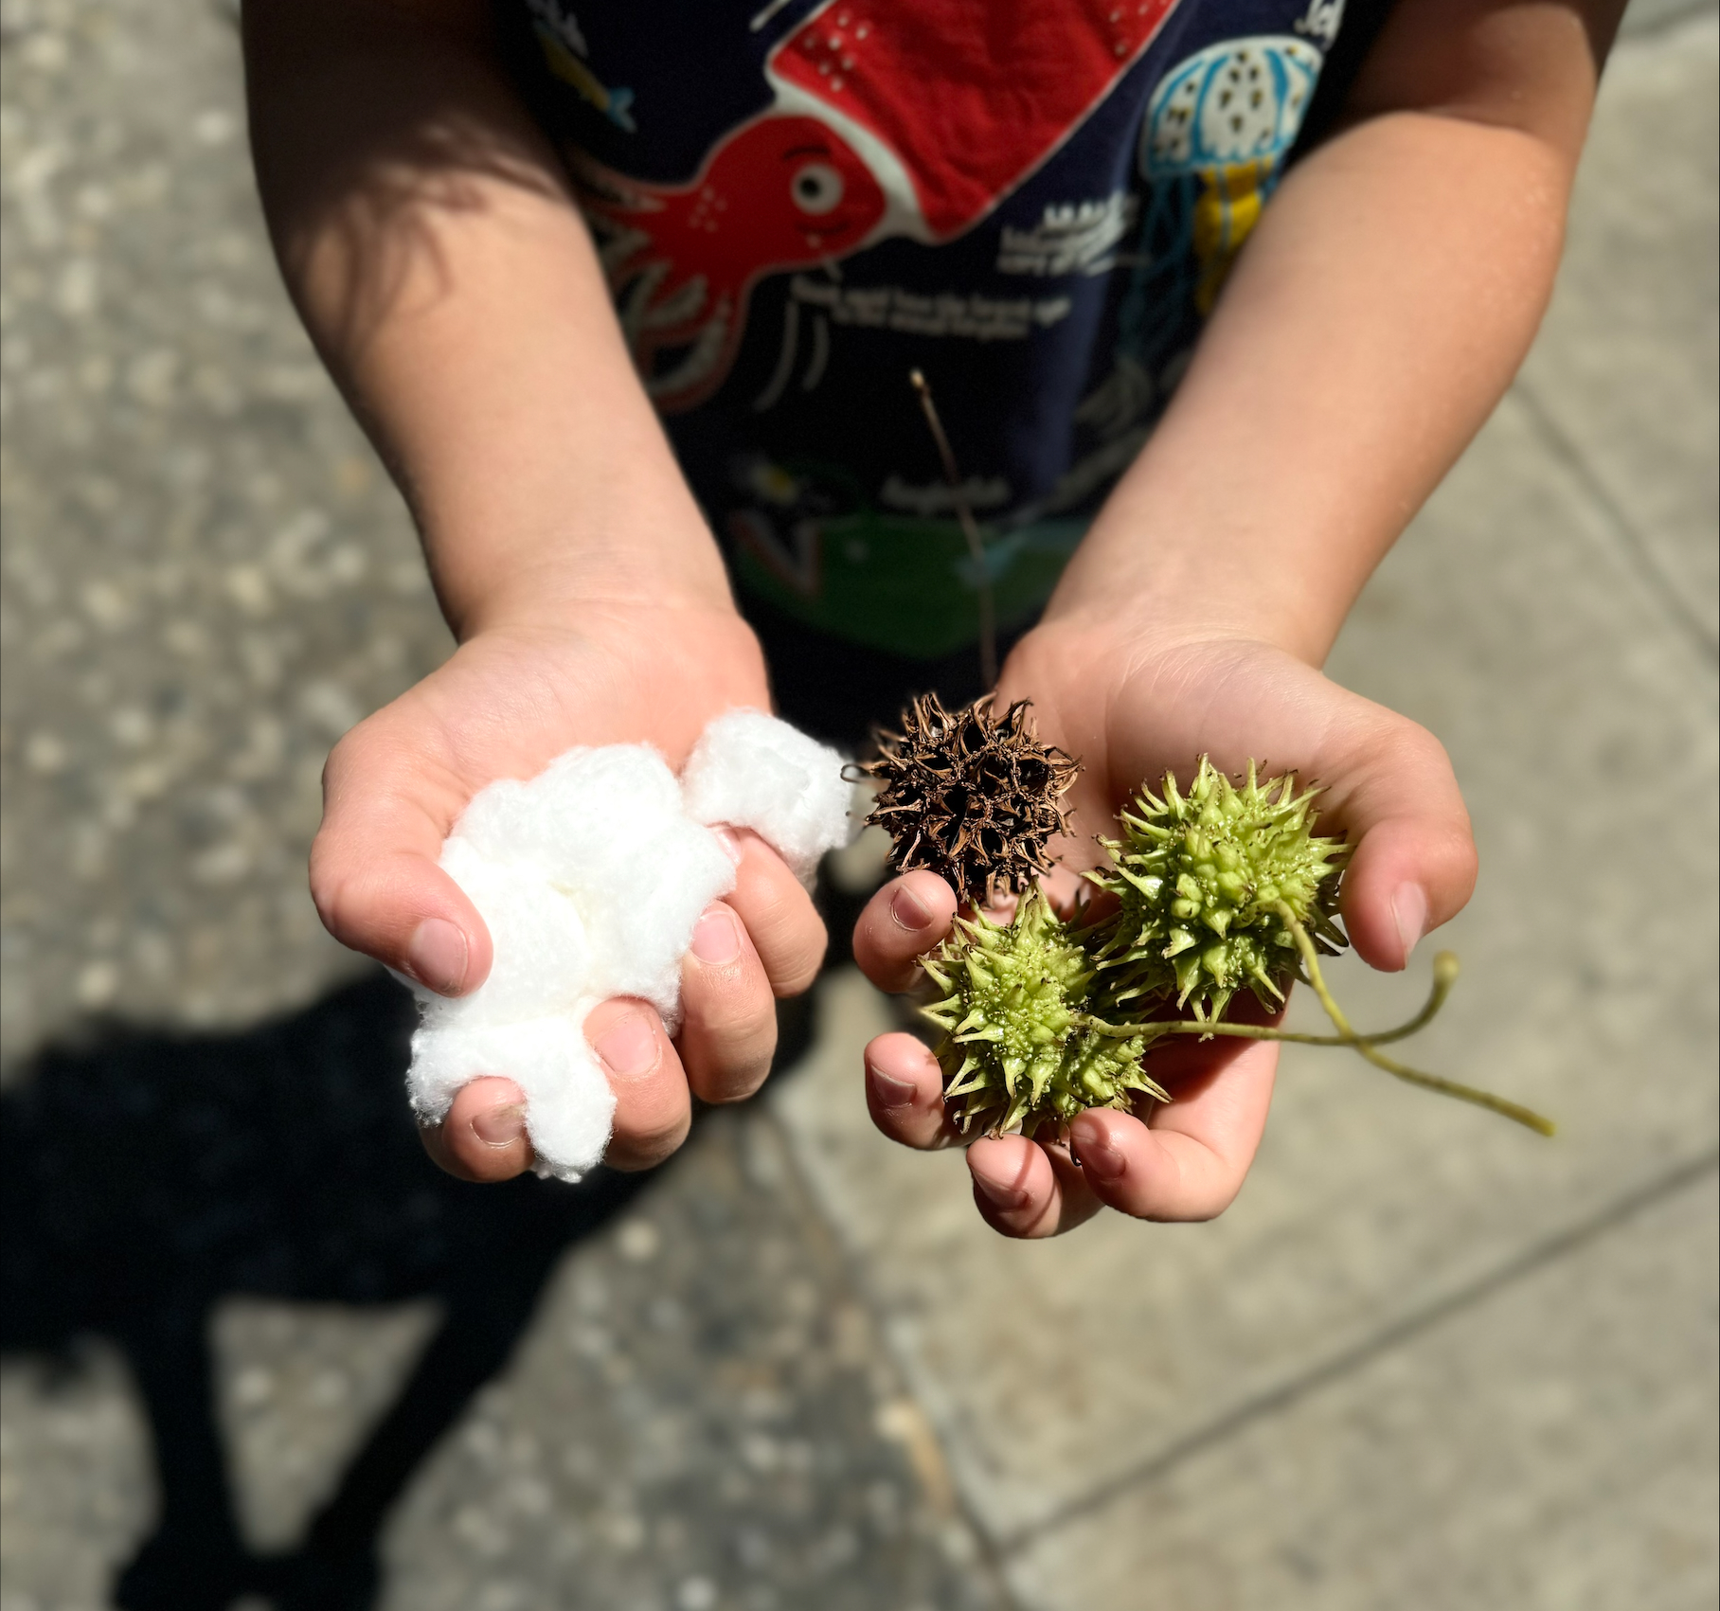
OBJECT LESSON
Insert silhouetted, background, or full-bleed image in this slide, then delete this text box
Notes:
Pass around a bucket filled with pom-poms or cotton balls or pass out a cotton ball. Have the students feel it. Ask: How does it feel? These cotton balls are for kind words and happy feelings. Who can name a kind word? What are happy feelings? TK K © 2024 YMCA Project Cornerstone | www.projectcornerstone.org 4 Then pass out a bucket filled with seed pods from Liquid Amber trees. Have students put their hand in the bucket. Ask: How does this bucket make you feel? Say these represent mean words and sad feelings. • Which bucket feels best? • Which describes your day today? • What can we do to be a bucket filler and fill other people’s buckets? Have the class popcorn their answers as you write them on a bucket poster. If time, act out the actions together. o Give someone a compliment. o Give a hug. o Help clean up. o Invite someone to play. o Say hello with a smile. o High five a classmate

Slide 20
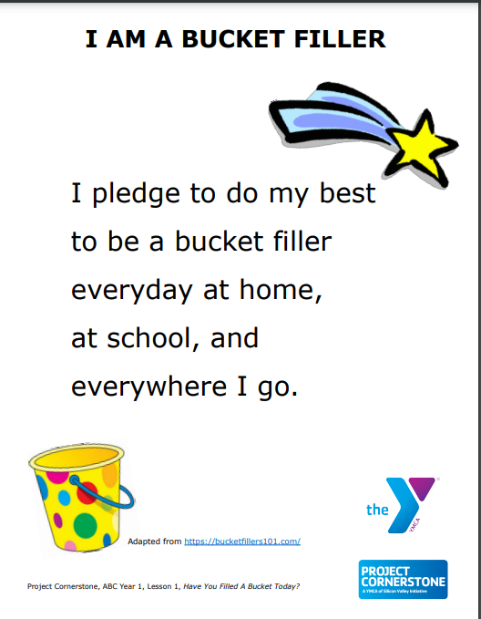
CLOSING
Add movement
Should feel like a fun together activity
| ITLE | ©2024 PROJECT CORNERSTONE
Notes:
FOR TK they are already standing up after filling up their buckets with smiles- You can have them stand and repeat- We are bucket fillers, yes we are! Or the pledge repeat after me- which I prefer actually because you’re committing to something together

Slide 21
SCHOOLWIDE EXTENSION
Talk with your Lead about how you can implement something schoolwide, or you could keep it to Transitional Kindergarten/Kindergarten as they are often on the same playground.

Slide 22
How to Fill a Bucket
Bucket Filler Buckets
More of a home extension with the students bringing their bucket ideas home and having the opportunity to share with family
For extension throughout the month. This encourages students to continue to use the language of bucket filler. This also focuses on the positive parts of our buckets
Notes:
How to Fill a Bucket Materials: Bucket handout for each student, crayons Have the students draw a picture of something they can do to fill a bucket. They can dictate a sentence to an adult. Attach the parent letter to the bucket and send them home. The buckets could also be posted on a bulletin board
Bucket Filler Buckets Materials: small paper cups, pipe cleaners, markers or stickers to decorate, stars and heart cut outs 1. Pre-write names on the front of the cup. Labels could also be pre-made, and students can place them on the cup. 2. Pass out stickers and decorate their buckets. 3. Attach a pipe cleaner after, to make the handle. 4. Pass out a star or heart have student draw a way to fill a bucket. 5. Attach the buckets to a bulletin board. 6. Add a pom-pom or cotton ball to their buckets when students do a bucket filling action or fill someone else’s bucket with kind words

Slide 23
Thank you for being a Bucket Filler and starting off the year right!
| ITLE | ©2024 PROJECT CORNERSTONE

