Slide 1
Have You Filled A Bucket Today?
And other Bucket Books
ABC ASSET YEAR LESSON 1
PROJECT CORNERSTONE
Notes:
This presentation is intended for use as a training resource for ABC Leads at the monthly ABC Lead training hosted by Project Cornerstone. Many of these slides provide additional materials and resources for ABC Leads and ABC Readers to compliment and update the Lesson Plan.
ABC Leads are encouraged to use this resource to support their own school site ABC Reader training. Notes for facilitating a discussion with this presentation accompany each slide.

Slide 2
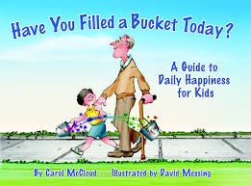
Schedule for Training:
- The Role of the Volunteer and ABC Review
Summary of Books in Lesson
Overview of Lesson, examples of activities by Grade Level
Classroom Management Tips
Q & A

Slide 3

We are Growing Upstanders!
Notes:
Definition of UPstander
An UPstander is someone who stands up for others by using kindness and empathy to do the right thing. Dependent on standing up for others is the ability to build and maintain healthy relationships.

Slide 4
The Role of the Volunteer
You are a Bucket Filler!
You are an example to these children!
You are an empathetic and active listener!
You are helping to create a positive and supportive classroom climate!
Notes:
Clearly define the volunteer's role in promoting bucket filling.
Emphasize the importance of being a positive role model.
Discuss expectations for attendance, punctuality, and communication.
Share the importance of creating a positive and supportive classroom climate.

Slide 5

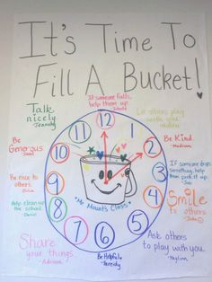
From the very first moment, invite children to build a relationship with you!

Slide 6
ABC Rules
Be Respectful
Raise your hand.
Take turns.
Be an active listener.
Give your Total Support for sharing ideas & feelings.
Treat others with care.
Use a “no name” policy. *
Be Responsible Be Safe
Use positive language. Keep your hands and
Be helpful. feet to yourself.
Be forgiving. Follow directions.
Be kind.
Notes:
Remind the volunteers that they are there to model and remind students of these rules during their lessons

Slide 7
Reflection Question:
How have you been effective in building relationships and modeling positive behaviors in classroom settings?

Slide 8
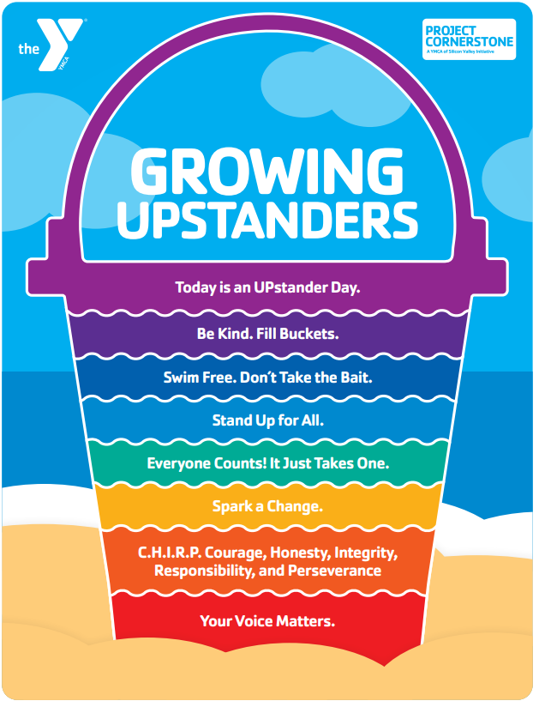

Slide 9
Mindfulness Activity: Remembering Joy
Linked on materials page.

Slide 10
Have You Filled a Bucket Today?
(K-2nd )

Slide 11
Conversation Starters

Slide 12
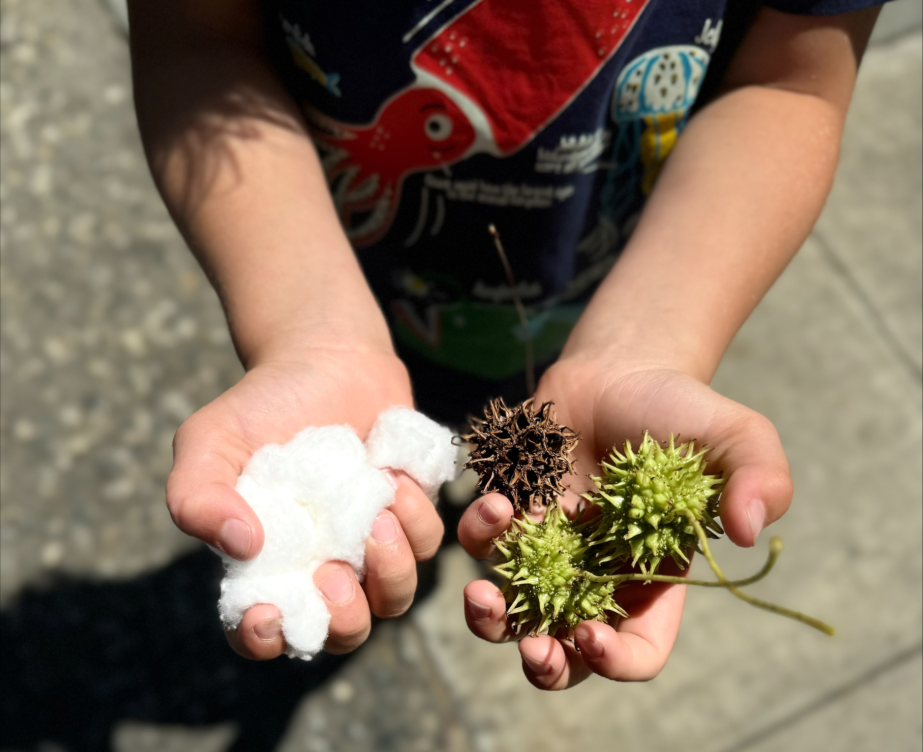
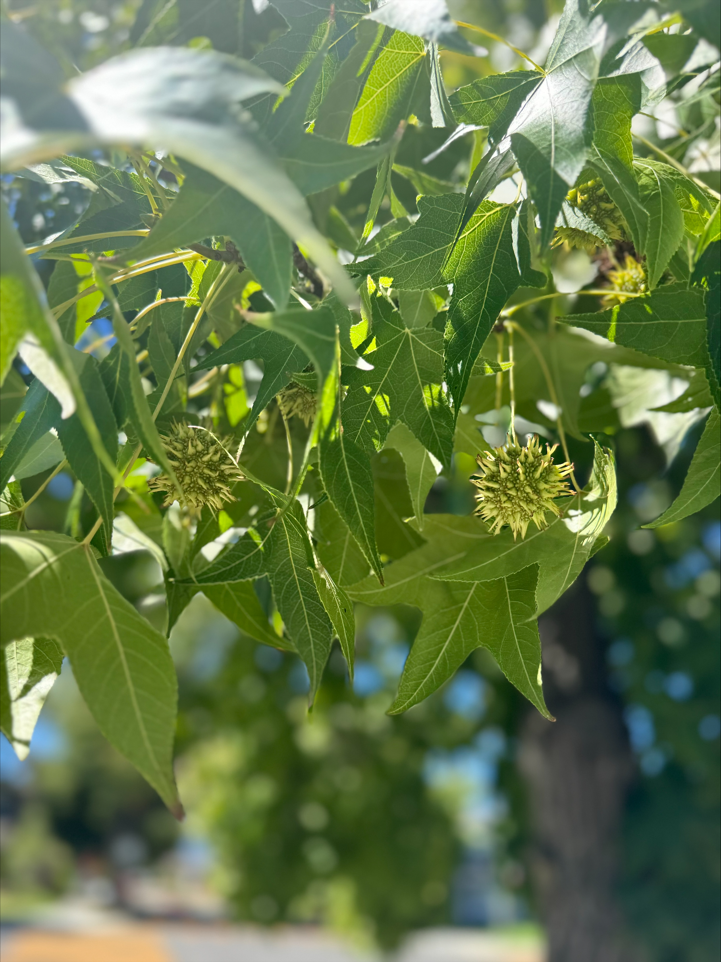
Soft and Prickly
Show them the difference between positive and negative feelings
Notes:
Pass around a bucket filled with pom poms or cotton balls. Say these represent happy feelings and good thoughts. Then pass out a bucket filled with seed pods from Liquid Amber trees. Say these represent negative and sad feelings.
Ask which one feels best.
Which one would you like to experience daily?
Show that with enough happy feelings and good thoughts, the negative ones can be covered and don’t hurt as much.
Tell the class that today you are going to read a book that talks about ways you can be kind and feel happy, and make others feel happy.

Slide 13
Reading
The Book

Slide 14
Pre-Reading Set Up
To be linked on the website under Videos for this Lesson

Slide 15
Reading the Book
Work with the teacher ahead of time to know where you and the students will be during the reading
Give students a preview of what the book is about
Ask them to look for something specific, or think of something (i.e. what emotions do you notice?) while you read the book

Slide 16
Tips for Reading to 5- 8-year-olds
Engage with visuals: Point to pictures, ask questions about them, and encourage students to describe what they see
Vary reading styles: Use different voices, pacing, and intonation to bring characters to life.
Incorporate props: Use puppets, costumes, or objects to enhance the story.
Encourage predictions: Ask students to guess what might happen next in the story.
Keep them on topic: Refer them back to the lesson and book facts *when* they share unrelated details

Slide 17
Engaging with students while reading
https://www.youtube.com/watch?v=MXPx5S-1Kic

Slide 18
Discussing
The Book

Slide 19
Questions for Younger Students:
Who has a bucket?
Why do we want a full bucket?
What does it feel like to have your bucket filled?
Why do people sometimes dip from buckets?
What are ways people dip?
How can you use your lid to protect yourself from bucket dipping?
How can you use your lid to protect others from bucket dipping?

Slide 20
Activity Ideas

Slide 21
What would you do?
Simple role play practicing filling buckets.
https://www.youtube.com/watch?v=0TUxf317AjE
Notes:
Have students pair up, face each other and practice the following bucket filling ideas:
Show different ways to greet one another (good morning, smile, high five, wave etc…)
Act out how students can actively listen to someone speaking to them and share something good about their week.
Ask two students at a time to act out these scenarios at the front of the room or think of more!
Someone was running on the playground and fell. They look upset. What could you do to fill their bucket?
As you are walking to school, you find a wallet. What can you do to be a bucket filler?
You see someone cut in front of another person for the monkey bars in a rude way. How can you protect their bucket?
You want a book someone else has. You ask them if you can have a turn. They say, “No.” How can you respond in a bucket filling way?
When a parent comes home from work, they say they had a bad day. They yell at you to pick up your toys. You realize their bucket is low. What can you do to fill their bucket?

Slide 22
We Choose Bucket Filling
https://www.youtube.com/watch?v=pcqr2DK2RpU
Notes:
Materials: Large poster or butcher paper with bucket drawn on it, writing tools, and optional post its
Tell students we are going to make a big visual of ways to fill each other’s bucket to display in the room.
Put students in small table groups to brainstorm how students can fill their classmates’ buckets (say hello, wait your turn, give a compliment, do what you say you will do).
Have each group come up and write their ideas into the bucket, effectively filling it for everyone.
For younger students, ask them to brainstorm together and give each student a piece of paper to draw a picture for their idea (a hand waving hello, a smile, friends playing) and then write the words down next to the picture once it is up on the bucket.

Slide 23
Closing:
3-Minute Huddle
Notes:
Role model how to be a bucket filler by saying something kind to someone in the classroom.
• Ask volunteers to demonstrate how to be a bucket filler by saying:
I like the way you…
You are really good at…
One quality I have noticed about you is…
• Ask students to exchange words of affirmation with a partner.
Challenge: Tell students that you care. Ask students to share their progress with you when they see you around school!

Slide 24
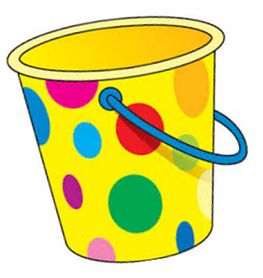
3-Minute Huddle: Reinforce key concepts and prompt a call to action
          I AM A BUCKET FILLER
          I pledge to do my best
          to be a bucket filler
          every day at home, at school,
          and everywhere I go.
              BUCKET FILLER PLEDGE
              I promise to do my best everyday
              to be a bucket filler,
              to not dip,
              and to use my lid
              for myself and others
              at home, school, and everywhere I go.

Slide 25
Classroom Management Tips

Slide 26
Effective Behavior Management Strategies
Use proximity control:
Move closer to a student who is off-task to redirect their attention.
Offer choices:
Give students opportunities to make decisions, which can increase their sense of control.

Slide 27
Buckets, Dippers, and Lids (3rd-4th)
Growing Up with a Bucket Full of Happiness (5th-6th)

Slide 28
Conversation Starters

Slide 29
Cotton Ball Competition
https://www.youtube.com/watch?v=HCDWLGWoig0
Notes:
This might be a rowdy one, depending on your class, but I promise getting the kids moving will also get them thinking.

Slide 30
Reading
The Book

Slide 31
Example of PreReading
https://www.youtube.com/watch?v=nY5V1QEcCQk

Slide 32
Tips for Reading to 8-12 Year Olds
Use think-alouds: Share your thought processes as you read, modeling critical thinking and comprehension strategies.
Promote discussion: Encourage students to share their thoughts and feelings about the story (these thoughts can be referenced later in the discussion- remember you are modeling for the students!)
Vary the pace: Mix longer readings with shorter to help keep them engaged.
Ask open-ended questions: Encourage students to think critically about the text and support their answers with evidence.

Slide 33
Discussing
The Book

Slide 34
Setting them Up for a Positive Discussion
Remind them of “no name” rule
We don’t share stories including someone’s name- in this class or outside of this class
Thank them for sharing ideas
As they share, make sure to make it clear you heard them and you appreciate them speaking up
If there is a lull, you can allow for them to have some thinking time, and also give examples
Sometimes that question isn’t clear for them

Slide 35
Questions for Buckets, Dippers, and Lids
How does it feel when your bucket is filled?
What are some ways you like to fill other people’s buckets?
We all receive and give love in different ways. How do you like to show kindness? How do you like to receive kindness? (If examples are needed you could refer to the 5 love languages: service, kind words, physical touch, gifts, time together)
When have you let angry feelings become hurtful words? How do you keep yourself from dipping into other’s buckets?
What were some of the “secrets to happiness”? (learn to fill buckets, resist the urge to dip, use your lid) Think silently about one of those three tools you could improve.
How can we try to focus on filling each others’ buckets at school more effectively?

Slide 36
Questions for Growing Up with a Bucket Full of Happiness
Ask Students the following questions after reviewing parts of the book:
How do you choose friends you want to spend time with? How do those friends treat others and how do they treat you?
How can you fill your own bucket at school? At home?
Who can you talk to about your bucket?
How can you be better at the second rule: Don’t Dip?
What can you do when you feel yourself dipping into your own bucket?
Have you learned the law of the lid?
Can you think of a time when you used your lid to protect yourself or others?

Slide 37
Activity Ideas

Slide 38
What would you do?
In the lesson plan, this is listed for K-2, but you can always adapt any part of the lesson to different ages, and role playing is always a powerful teacher!
Adapt to their experiences
Come with examples ready to go
Notes:
Examples include: Someone tells you something about another person that isn’t kind. A kid in your class always seems to be last in line for the cafeteria. At the pool you see an older kid in a life jacket.

Slide 39
Name Game Bucket Filling
Give students practice in giving and receiving compliments.
A positive way to start building relationships within the classroom.
Set them up for success with a word bank you post up in the room and walk around with them while they are completing this activity
An adaptation can also be to have them only pass their papers around to individuals sitting at their table with them.
https://www.youtube.com/watch?v=u6p8PbXxqZ4
Notes:
Example of instruction

Slide 40
We Choose Bucket Filling
https://www.youtube.com/watch?v=Re26Ag2g0hw
Notes:
Example of instruction for 3-6

Slide 41
Closing:
3-Minute Huddle

Slide 42
Reflection
Set an intention individually or as a class for the day, week, month, year.
Ask the students to close their eyes and think about a that they would like to put in someone’s bucket today. Keep their eyes closed and ask students to think again how it feels when someone dips from their bucket. What could students say or do to fill someone’s bucket and their own? Have students pair share with the person sitting next to them.
Thank students for their time and encourage them to set a goal to fill someone’s bucket every day.

Slide 43
Classroom Management Tips

Slide 44
Effective Behavior Management Strategies
Teach self-regulation:
Help students develop strategies for managing their emotions and behavior.
Use restorative justice:
Focus on repairing harm done and building relationships.

Slide 45
School Wide
Extensions

Slide 46
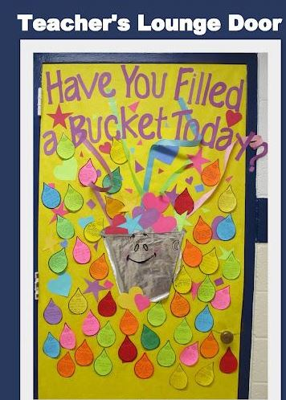
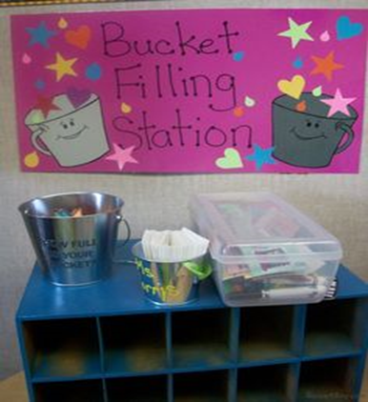
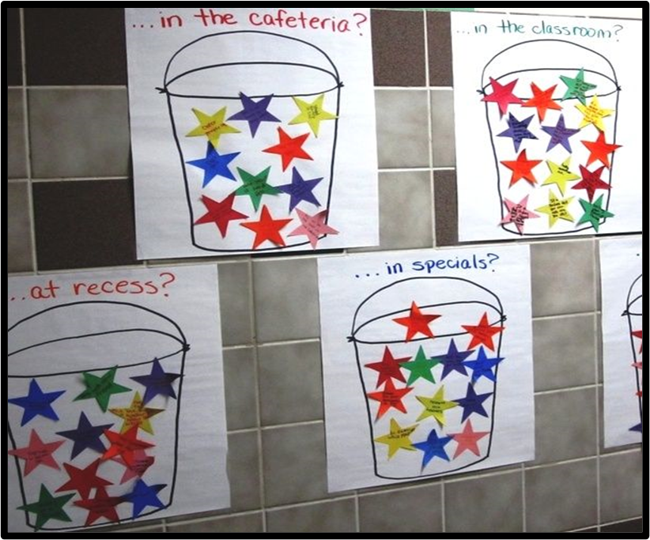
Schoolwide Bucket
Make the most of all students learning the same concepts!
Goal: One Schoolwide extension this year.
Notes:
This particular one can take a lot of planning- but it gets everyone talking and supporting and focusing on the positive things you are learning in class. Volunteer during recess and encourage other readers to do the same. You could even do it at the beginning of school for parents who cannot take more time out of their schedule to come work a recess.

Slide 47
Final Reminders

Slide 48
Parent Communication
The more ways you can communicate with parents, students, and staff the more they will internalize the tools.
School marquee
Send our parent/guardian newsletter home through the classroom teacher and school news
Print out stickers for students to wear home
Encourage students to fill up their family buckets
Create (or update) a Project Cornerstone section on your school’s website
Notes:
School Communication for Parents:
Share the message of bucket filling! Consider multiple ways of sharing the information from the ABC lesson:
Put the monthly tag line on the school marquee or on a school bulletin board.
Use the newsletter blurb or newsletter in your school news.
Send home the letter in hard copy or via email as a classroom or school blast.
Print out the stickers and have students bring or wear them home.
Send home blank Bucket Grams for families to fill out.
Post information on the school website. Create a Project Cornerstone section.

Slide 49
Closing Comments
Remind your ABC Readers of:
Setting up Reading Schedule with teachers
Meeting Schedule for Schoolsite Trainings
Asset Building opportunities at your school
Notes:
Remind your ABC Readers of:
Reading Schedule
Please encourage your volunteers to log all ABC activities on the sign in
Check this regularly to monitor volunteers
Planning Support and trainings
Grade Level meeting
Your 1:1 Coaching availability
Meeting Schedule
Be consistent
To the ABC Lead(s):
We will be asking you to report activity in November and March. Your reporting of #of volunteers, students, and classrooms numbers is essential to the financial stability of Project Cornerstone. We depend on your reports for our grant writing and funding requirements.

